Slide 1
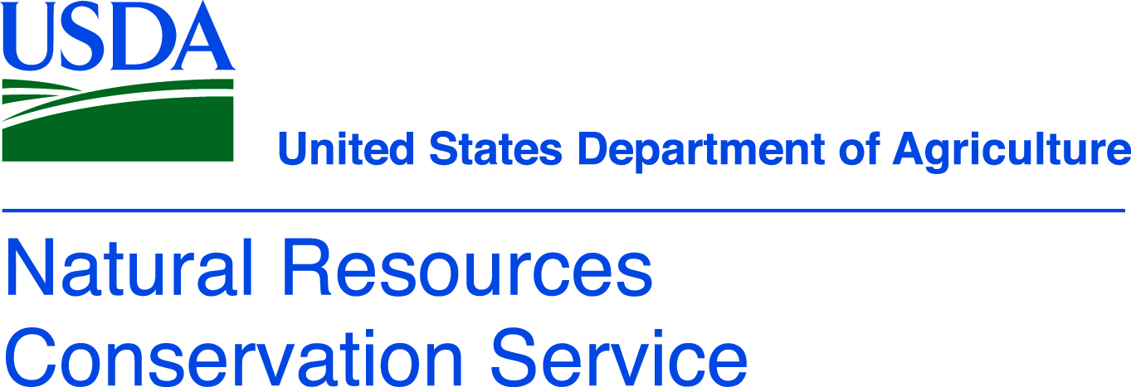
Soil Degradation

Slide 2
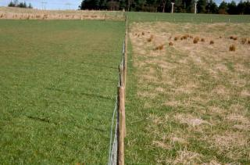
Extensification The geographic spread of farming/grazing into woodland areas. Using more land and fewer inputs per acre to achieve the same amount of production.
Pros
Cons
Less pressure on existing plant communities from non-cultivated acres (grazed)
Increase in diversity of plant community from non-cultivated acres (grazed)
Productivity can be stable
Better to manage year-to-year weather variations
Sometimes better carbon capture/storage in soil
Possible decreased pesticide use
Land is limited
Biodiversity is slow
Contributes to deforestation for the purpose of cultivation

Slide 3
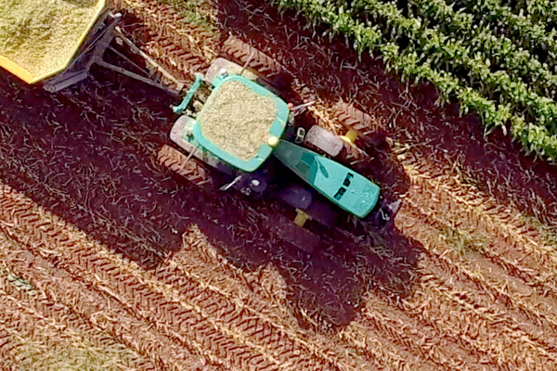
Intensification Increase in agricultural production per unit of inputs (which may be labor, land, time, fertilizer, seed, feed or cash)
Pros
Cons
Increased production
Specialization of skills
Mechanization, reduced labor needs
Lose biodiversity in favor of monocultures
Can lead to pesticides and fertilizers over applied and lost to watersheds impacting those environments
Significant alteration of the natural environment

Slide 4
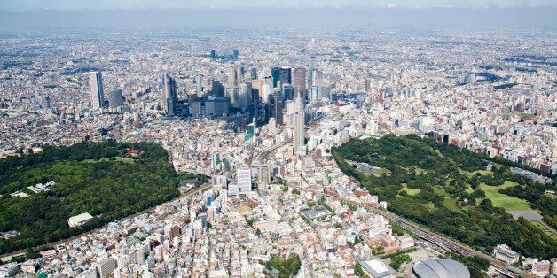
Urbanization Changing land use from agricultural production to homes and buildings due to an increase in human population
Pros
Cons
Human populations concentrated in smaller areas
Population centers are usually in prime agricultural areas (flat land, near rivers, lakes and oceans)
Urban sprawl takes up valuable agricultural land
Hard to transport agricultural goods to urban centers

Slide 5
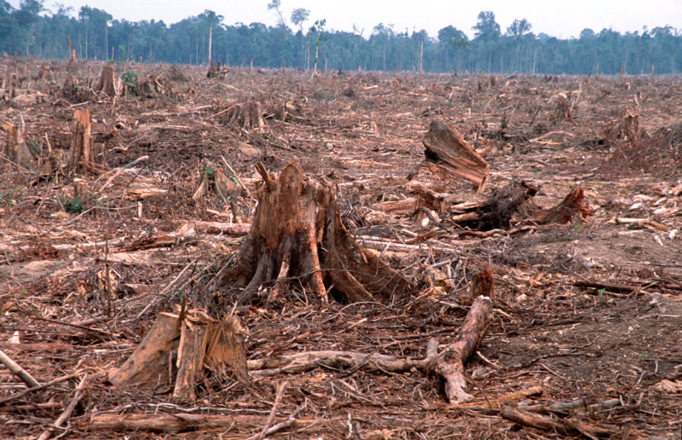
Deforestation Clearance, clearcutting or clearing of a forest or stand of trees from land, which is then converted to a non-forest use
Pros
Cons
More land is available for cultivation and agricultural production
Native plant communities are completely removed or significantly altered
Lack of ground cover increases soil temperatures and changes soil biology
Growing forests have high carbon-capture potential. Removal releases carbon into the atmosphere.

Slide 6
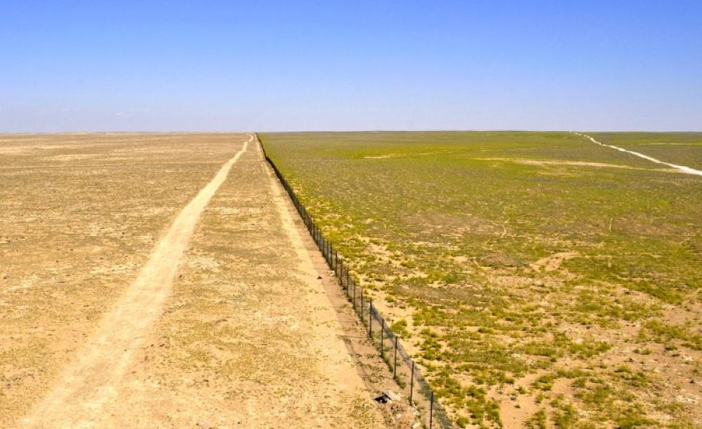
Desertification The process by which fertile land becomes desert, typically as a result of drought, deforestation, or inappropriate agriculture
Pros
Cons
N/A
Native plant communities are completely removed or significantly altered
Lack of ground cover increases soil temperatures and changes soil biology
Soil is easily eroded by wind and water

Slide 7
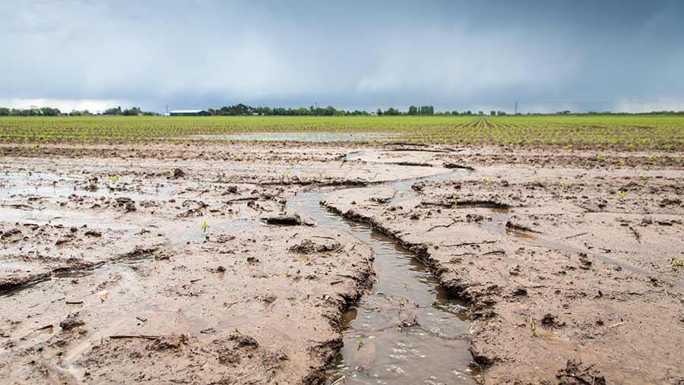
Erosion The process of soil being moved or carried away by wind, water, or other natural agents.
Pros
Cons
Water eroded soil can be deposited downstream to create rich deltas
Wind eroded soil can be deposited elsewhere creating rich loess soil
Wind and water carries away soil particles and topsoil creating less fertile fields
Water carries away nutrients including phosphorus which can pollute watersheds
Severe erosion requires mechanized shaping of soil to regain flat land to cultivate

Slide 8
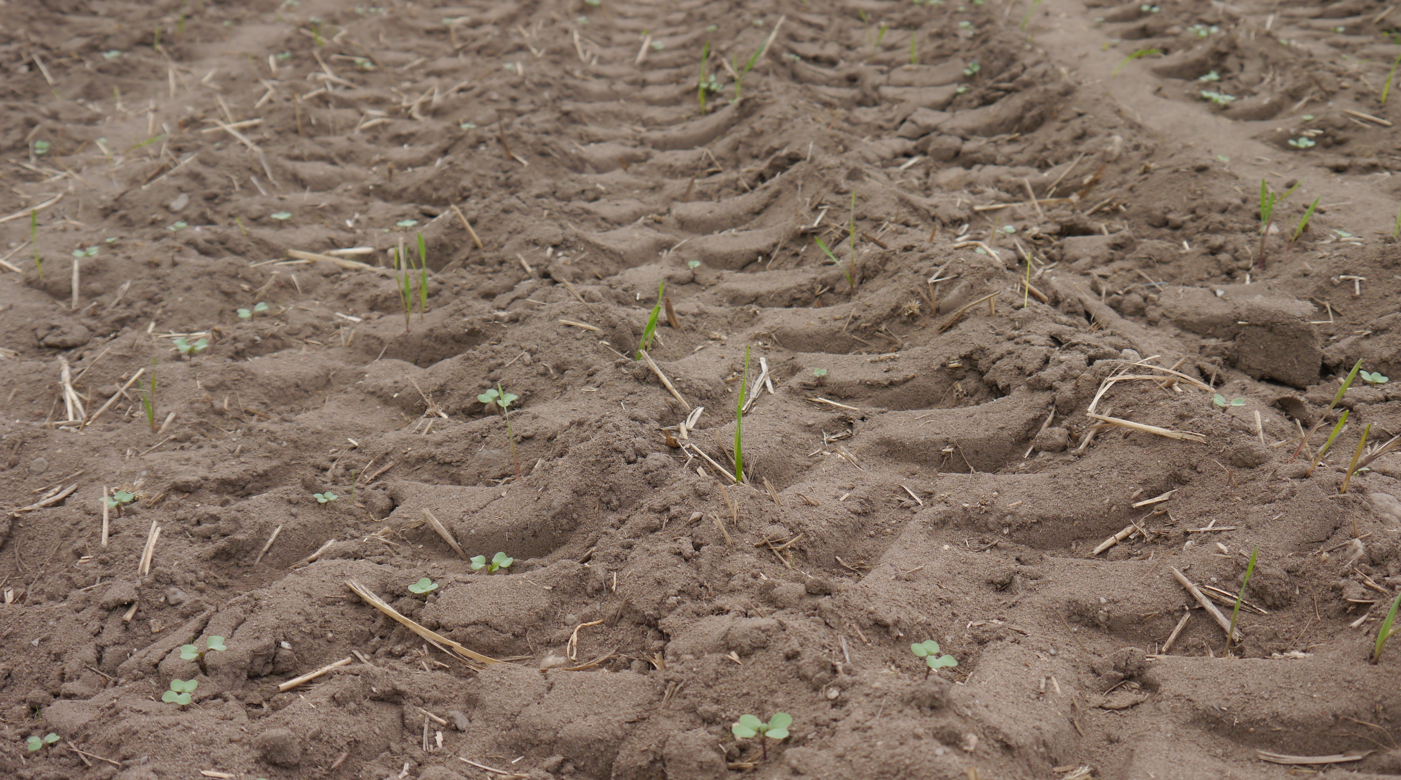
Soil compaction Compression of soil particles into a smaller volume, which reduces the size of pore space available for air and water
Pros
Cons
Makes for a more stable foundation for buildings
Reduces water infiltration into soil
Reduces macro and micro organism habitat
Reduces plant’s abilities to extend roots downward
Reduces seed’s ability to germinate
Breaks down existing soil structure

